Slide 2
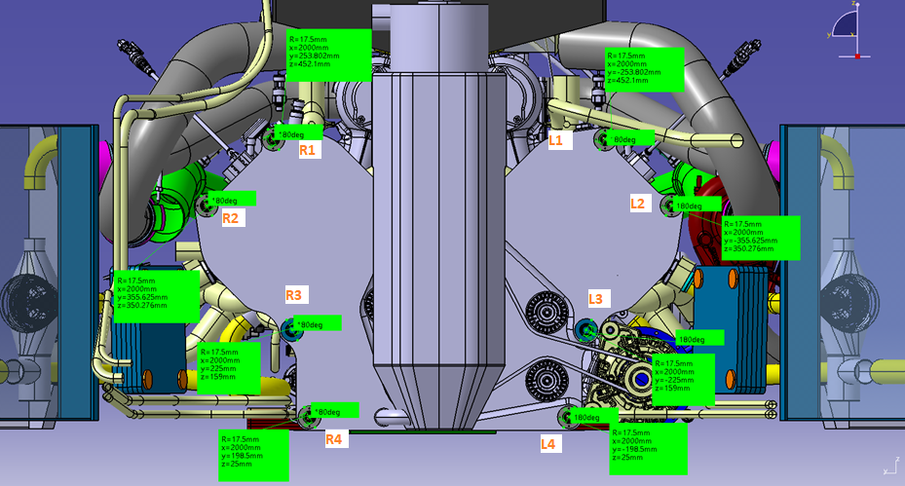
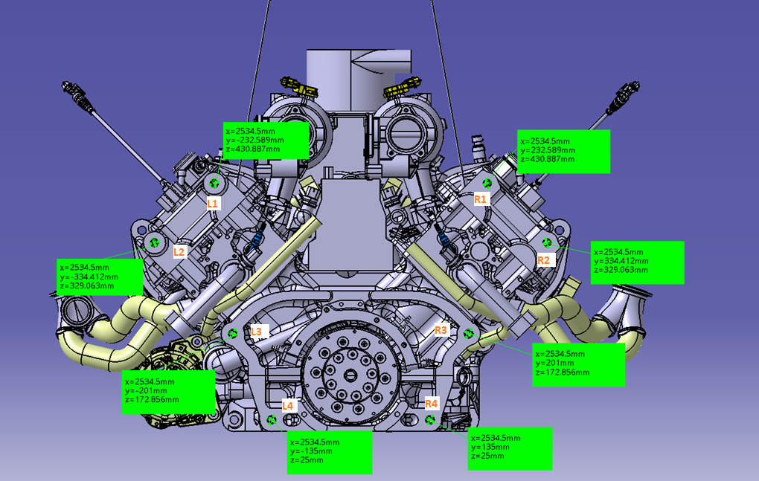
Studs overview
Monocoque to engine studs
Engine to bellhousing studs

Slide 3
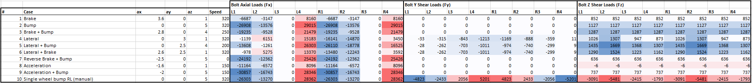
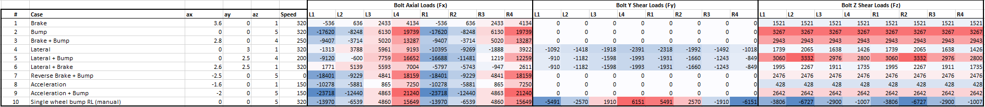
Load cases
Monocoque to engine studs
Engine to bellhousing studs

Slide 4
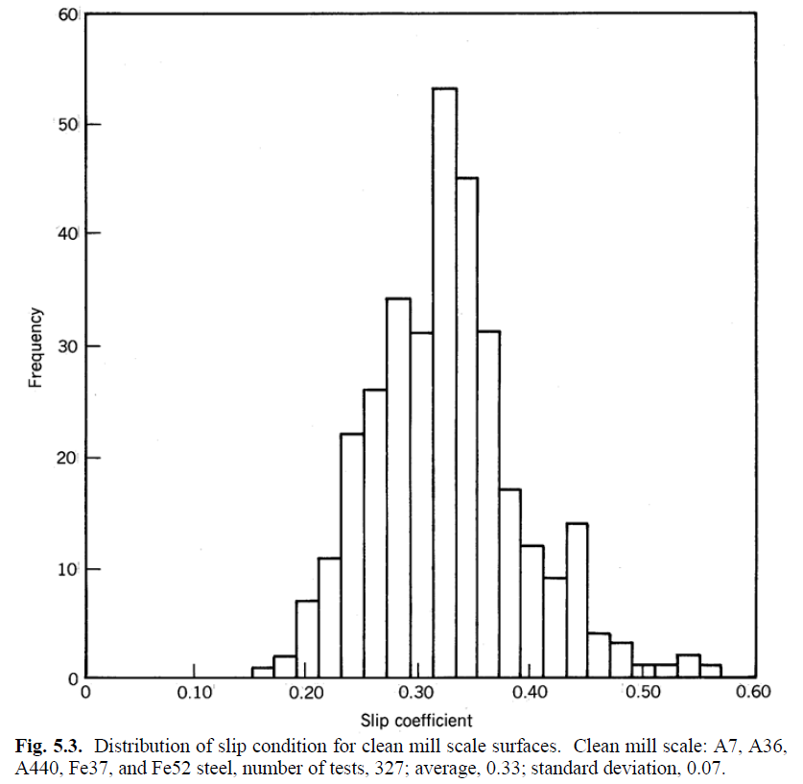
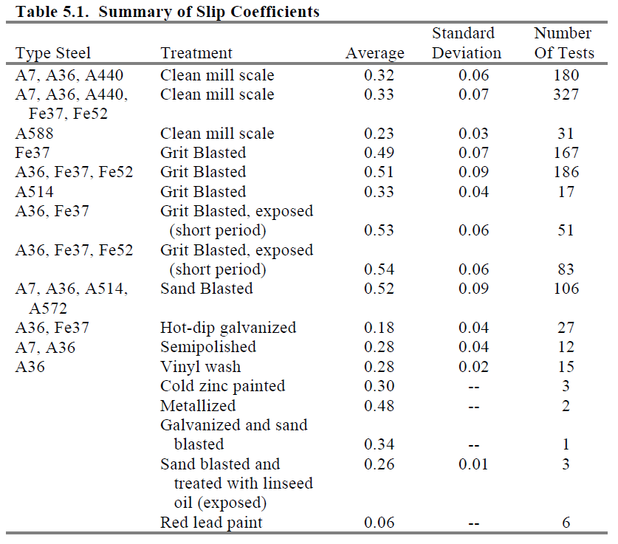
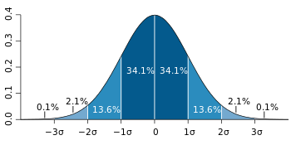
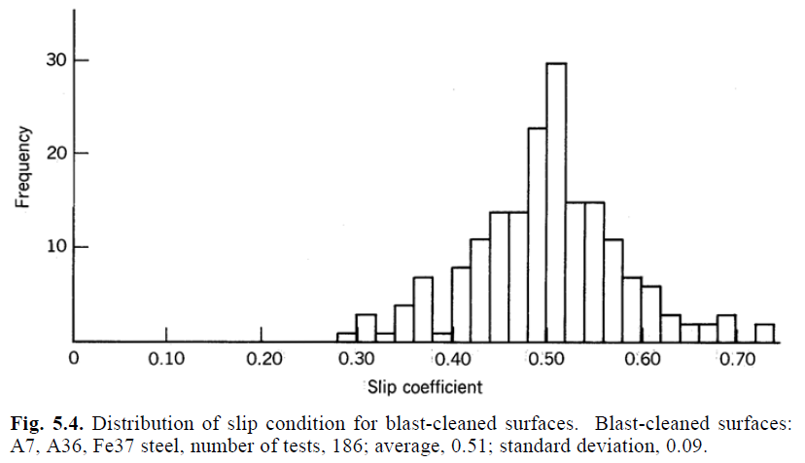

Steel-steel friction coefficient
Chosen friction coefficient
$$f=0.32−2∗0.06=0.2$$
Guide to Design Criteria for Bolted and Riveted Joints (Second Edition)
Geoffrey L. Kulak, John W. Fisher, John H. A. Struik
AMERICAN INSTITUTE OF STEEL CONSTRUCTION, Inc.

Slide 5
Aluminum – aluminum friction coefficient
Not found data of the same quality with respect to steel-steel friction coefficient
0.2 taken as a conservative reference
Table C2
ECSS-E-HB-32-23A
Space engineering - Threaded fasteners handbook

Slide 6
Tightening torque choice flow
Input – loads on studs, thread data, friction coefficients
Minimum required axial load calculation
Tightening torque choice to match the minimum required axial load
Check the clamping condition after external load application and torque uncertainty
OK
NOK
Stud SF check
OK
NOK
Tightening torque validation

Slide 7
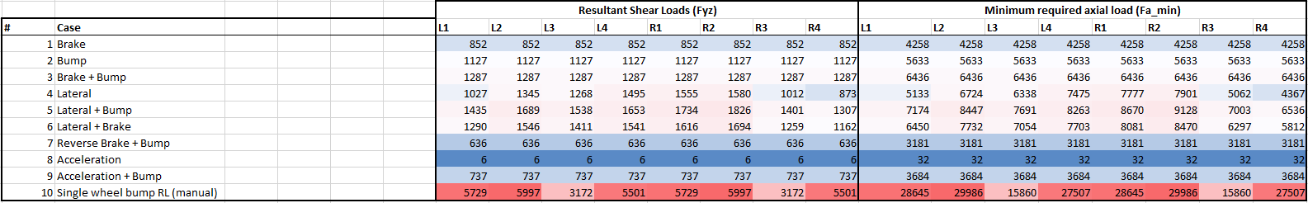
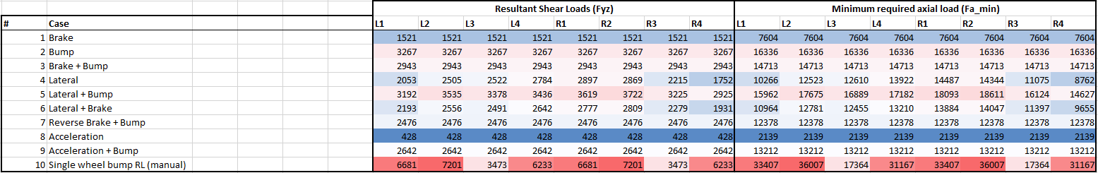

Required axial load computation
Minimum required axial load calculation
$$F_{a_min}=\frac{F_{yz}}{f}$$
Monocoque to engine studs
Engine to bellhousing studs

Slide 8
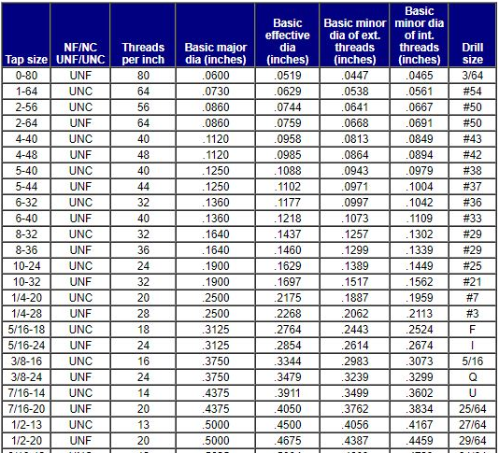
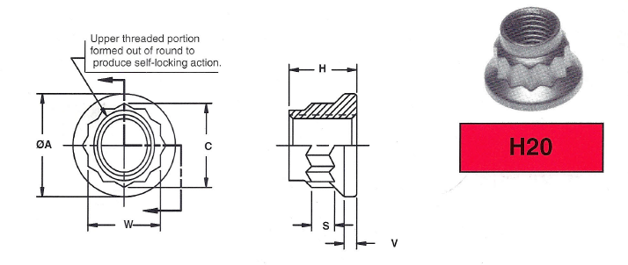
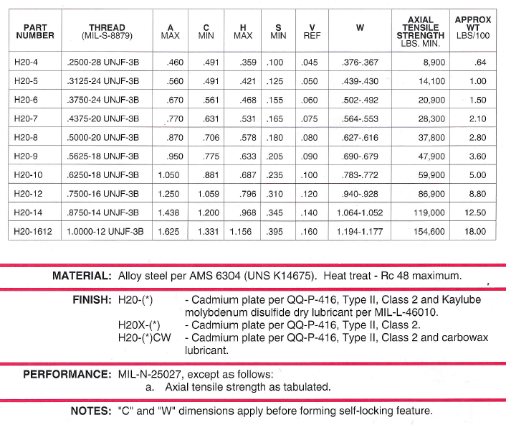
Thread data

Slide 9
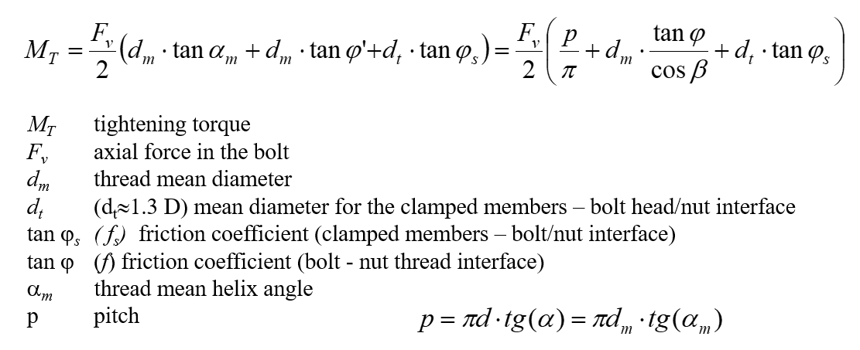
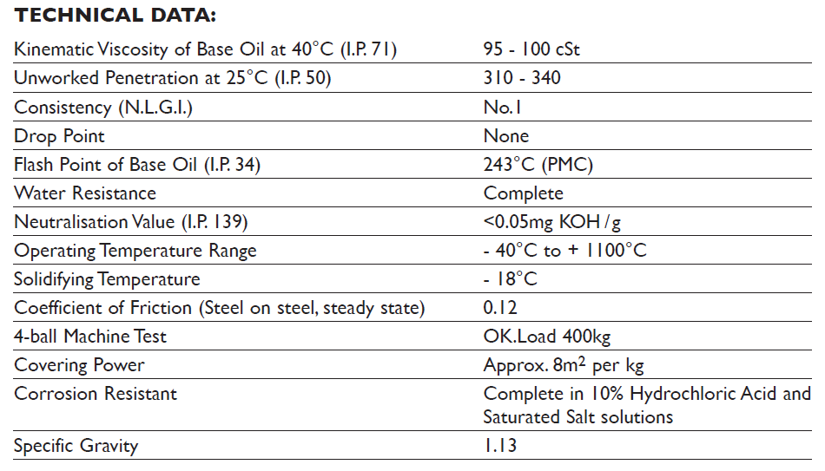
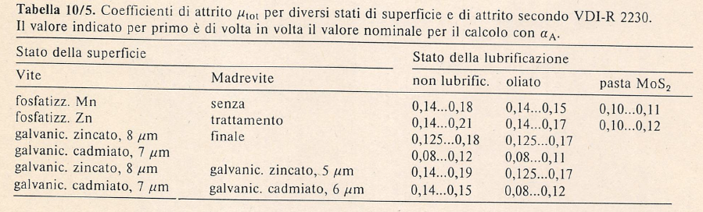
Tightening torque calculation output
Monocoque to engine studs: 85 Nm
Monocoque to engine studs shear only: 30 Nm
Engine to bellhousing studs: 85 Nm
Copaslip datasheet

Slide 10
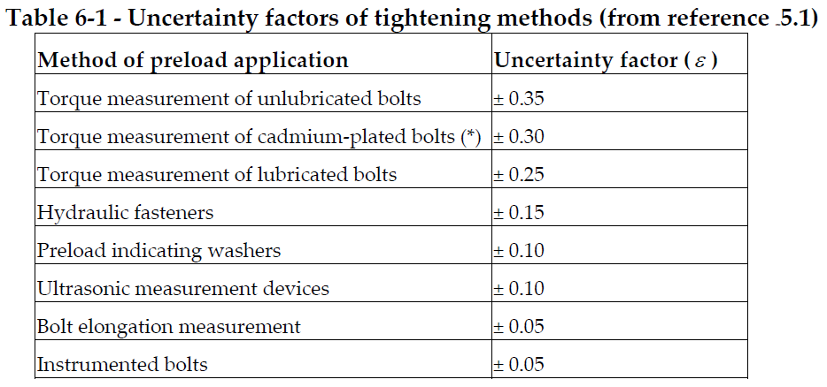
Tightening torque uncertainty
ECSS-E-HB-32-23A
Space engineering - Threaded fasteners handbook
Lower bound
Higher stress due to shear load on the screw
Lower stress due to tightening
Upper bound
Lower stress due to shear load on the screw
Higher stress due to tightening
Worst case scenario

Slide 11
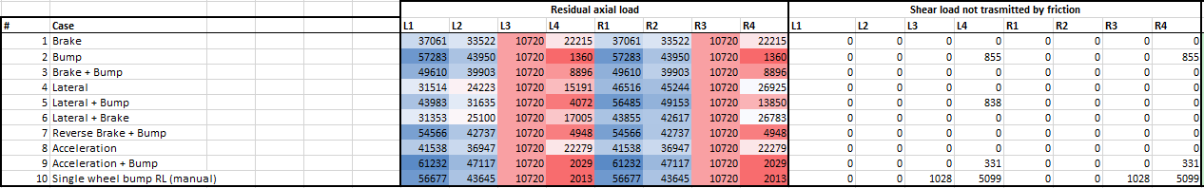
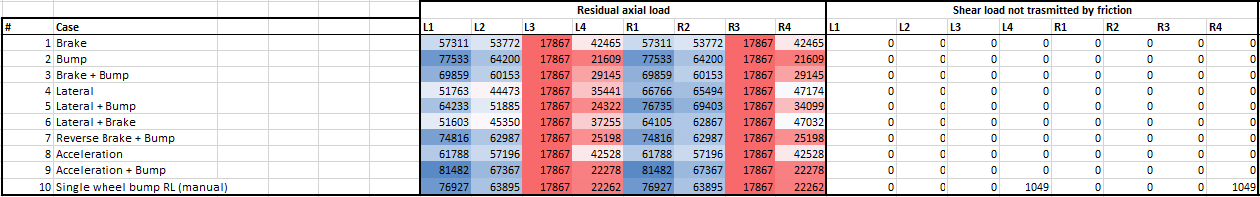
Residual axial load – Monocoque studs
Shear load transmittable by friction – shear load on the stud
Tighening preload lower bound (after torque uncertainty) - Fx
Minimum tightening torque
Tighening preload upper bound (after torque uncertainty) - Fx
Maximum tightening torque

Slide 12
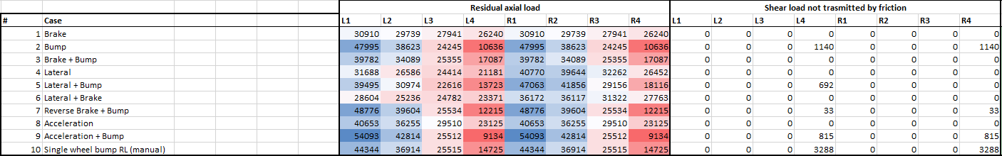
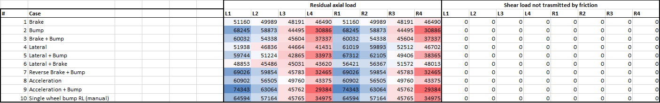
Residual axial load – Bellhousing studs
Minimum tightening torque
Maximum tightening torque

Slide 13
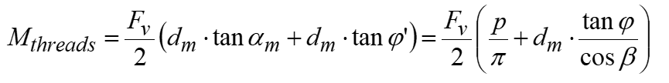
Stud safety factors
Operation SF
Loads: axial preload + peak external tensile load + torque from thread friction + shear load not transmitted by friction (if any) (Von Mises)
Minimum section
Monocoque to engine studs (17-4 PH H900 steel)
Minimum operation SF (max tightening torque): 1.3
Minimum operation SF (nom tightening torque): 1.5
Minimum operation SF (min tightening torque): 1.7
Tightening SF: 1.3
Tightening SF
Loads: axial preload + tightening torque (Von Mises)
Minimum section
Engine to bellhousing studs (17-4 PH H900 steel)
Minimum operation SF (max tightening torque): 1.4
Minimum operation SF (nom tightening torque): 1.7
Minimum operation SF (min tightening torque): 2
Tightening SF: 1.3

Slide 14
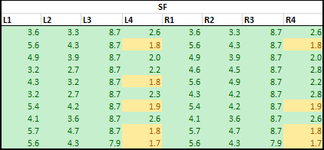
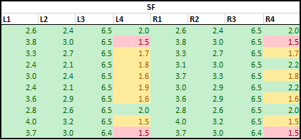
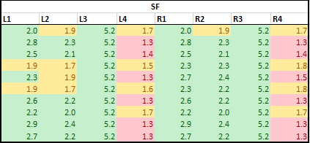
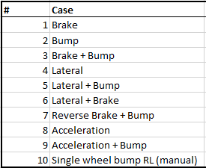
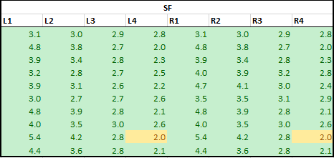
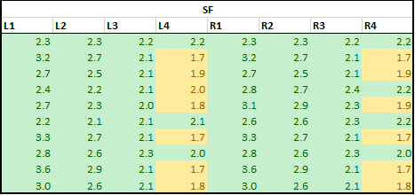
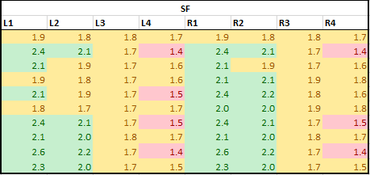
Stud safety factors overview (17-4 PH)
Monocoque to engine studs
Min tightening torque
Nominal tightening torque
Max tightening torque
Engine to bellhousing studs
Min tightening torque
Nominal tightening torque
Max tightening torque

Slide 15
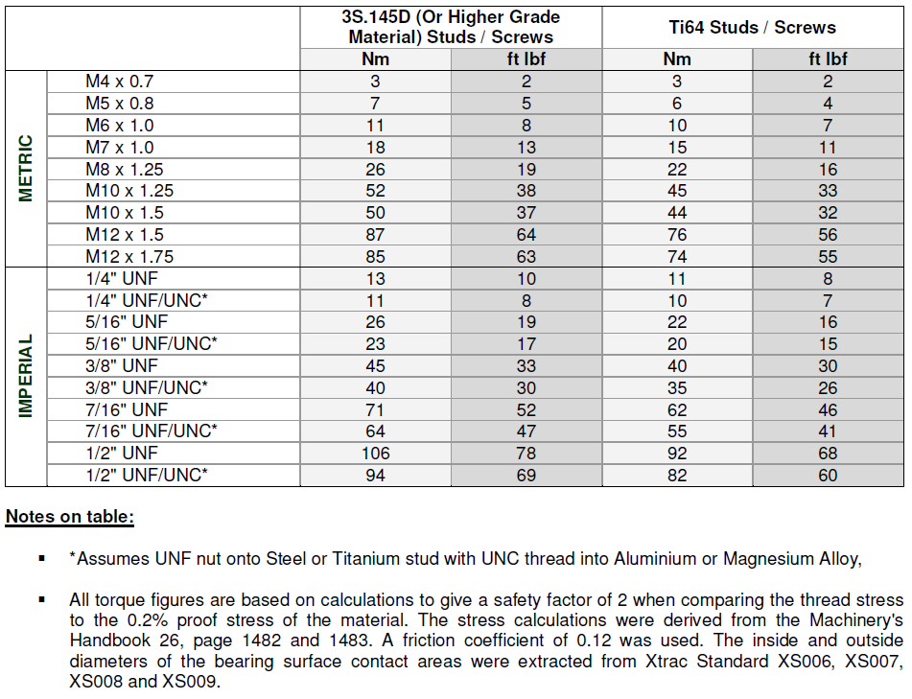
Xtrac reference

Slide 16
Conclusions
Monocoque to engine studs
85 Nm tightening torque
Max axial load under stud nut: 80 000 N
Lubricated threads during installation with COPASLIP
Engine to bellhousing studs
85 Nm tightening torque
Max axial load under stud nut: 72 000 N
Lubricated threads during installation with COPASLIP
Possible ways to improve the safety factor
13-8 PH used instead of 17-4 PH

